Slide 1

Project No. 06 PROMOTION OF BEE-KEEPING
MPR of HADP
November , 2025
SKUAST-Kashmir for Quality Life

Slide 2
MPR, November 2025
Target /Interventions | Budget Allocation | Funds Released | Expenditure up to 31st of March 2025 | Expenditure for the m/o September, 2025 | Achievements for the m/o November , 2025
Bee breeding centre for climate smart bees | 50 lakhs (2025-26) | 25 lakhs | 1.617 cr | Expenditure 25 Lakhs Funds has been released for the year 2025-2026 = 42 lakhs Liability for the year2024-25= 40lakhs Requisition for budget enhancement of Rs 30 Lakhs to the already sanctioned amount i.e., Rs 50 Lakhs for the smooth functioning of project | Installation of OTC (Open Top Chamber) system is completed
Disease diagnostic and quarantine centre |  |  |  |  | Targets for establishment of Disease diagnostic and quarantine centre is completed with all equipment's functional
Production of nucleus stock |  |  |  |  | Production of nucleus stock Is initiated Establishment of Insect Mini museum at Division of Entomology, SKUAST-K
 |  |  |  |  | All the Equipment's purchased under HADP-06 Project has been made functional and demonstration is carried out. Procurement Plan for the FY 2025-2026 has been Submitted to Directorate of Research Samples has been collected from different districts and analysed at Disease diagnostic and Quarantine centre, RTCPPPM Division of Entomology SKUAST-K.
Production of bee colonies by bee breeders

Slide 3
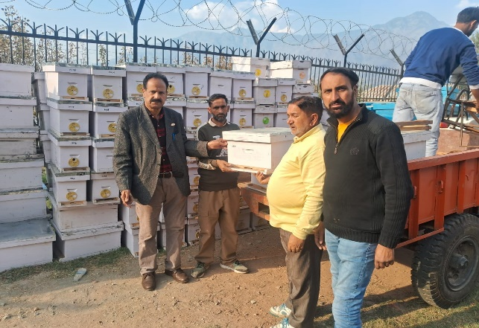
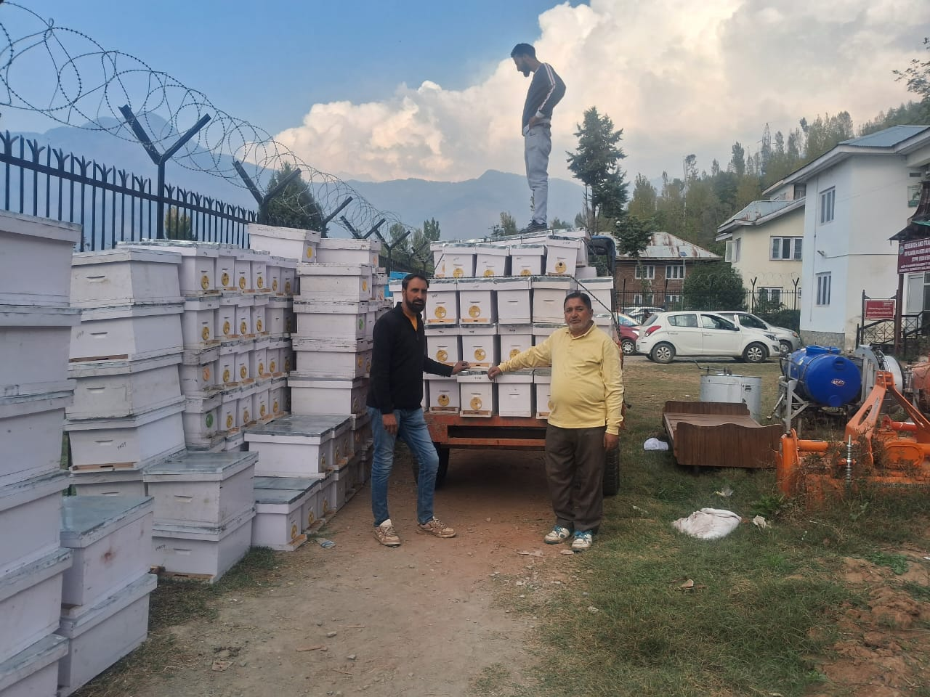
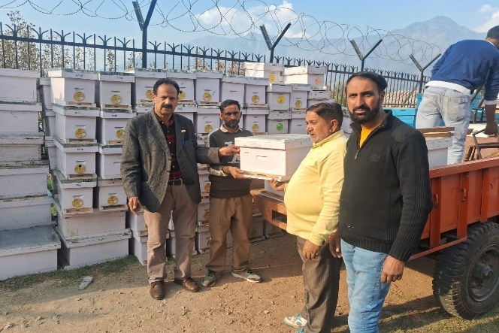
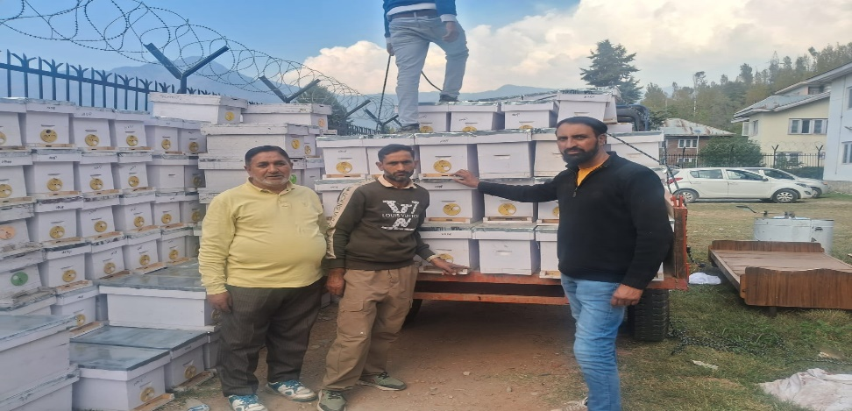
Distribution of Complete bee hives(16 Number) and 5 frame Nucleus hives (30 Number ) to KVK Ganderbal for strengthening bee breeding Center and Upgradation of existing Apiaries on 22-10-2025 under HADP -06 Promotion of beekeeping in UT of J&K.

Slide 4
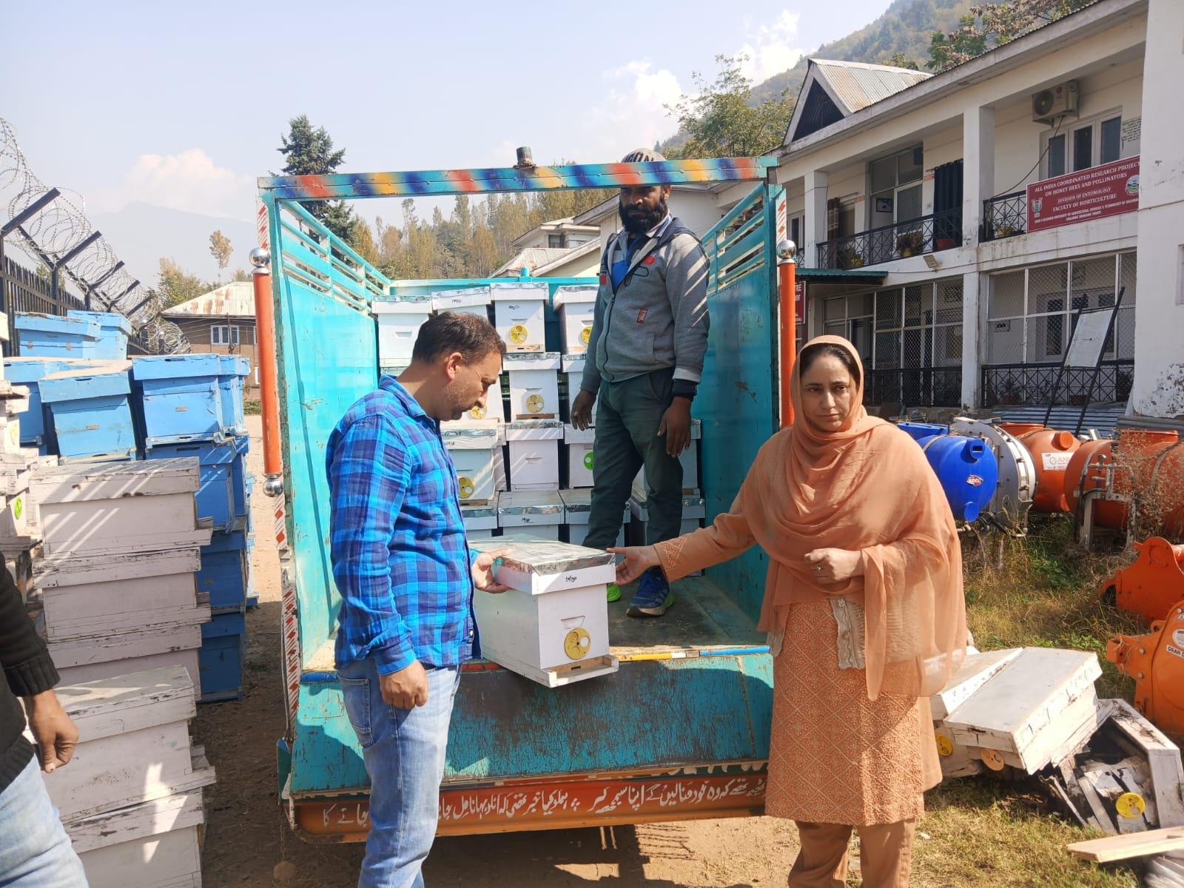
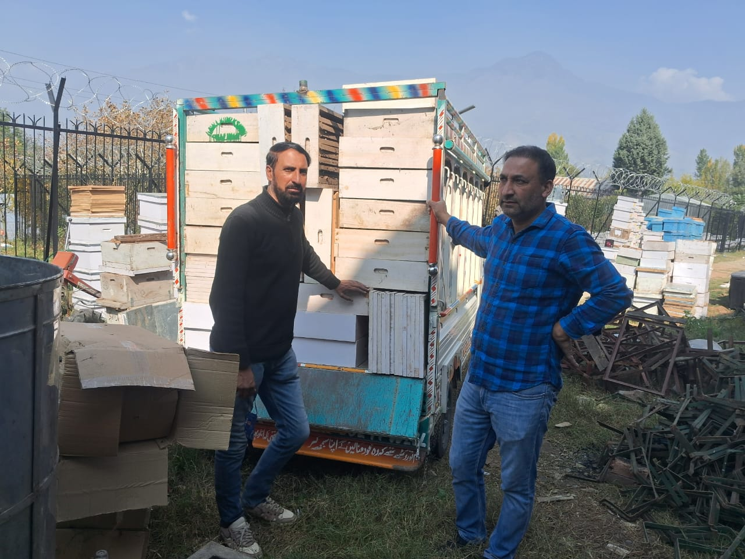
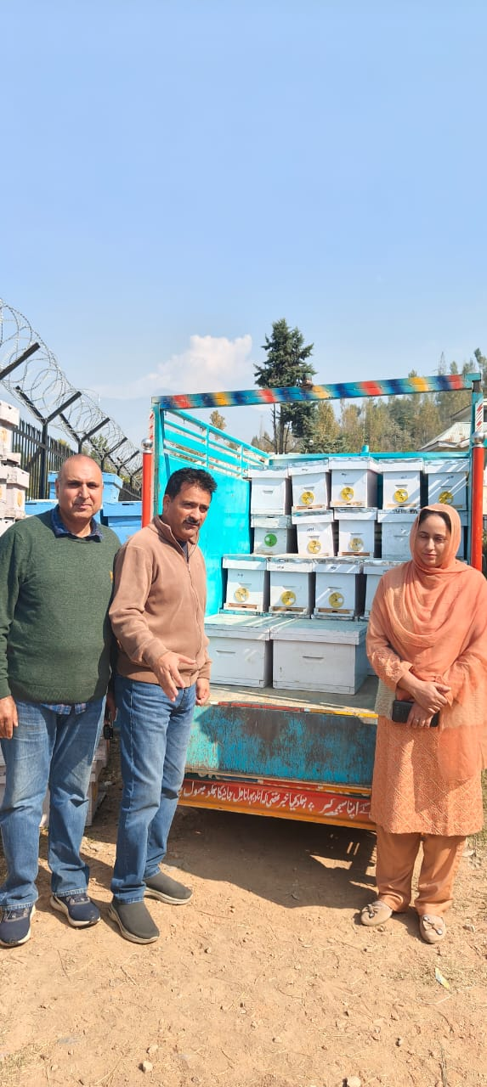
Distribution of Complete bee hives(17 Number) and 5 frame Nucleus hives (30 Number ) to KVK Pulwama for strengthening bee breeding Center and Upgradation of existing Apiaries on 22-10-2025 under HADP -06 Promotion of beekeeping in UT of J&K.

Slide 5
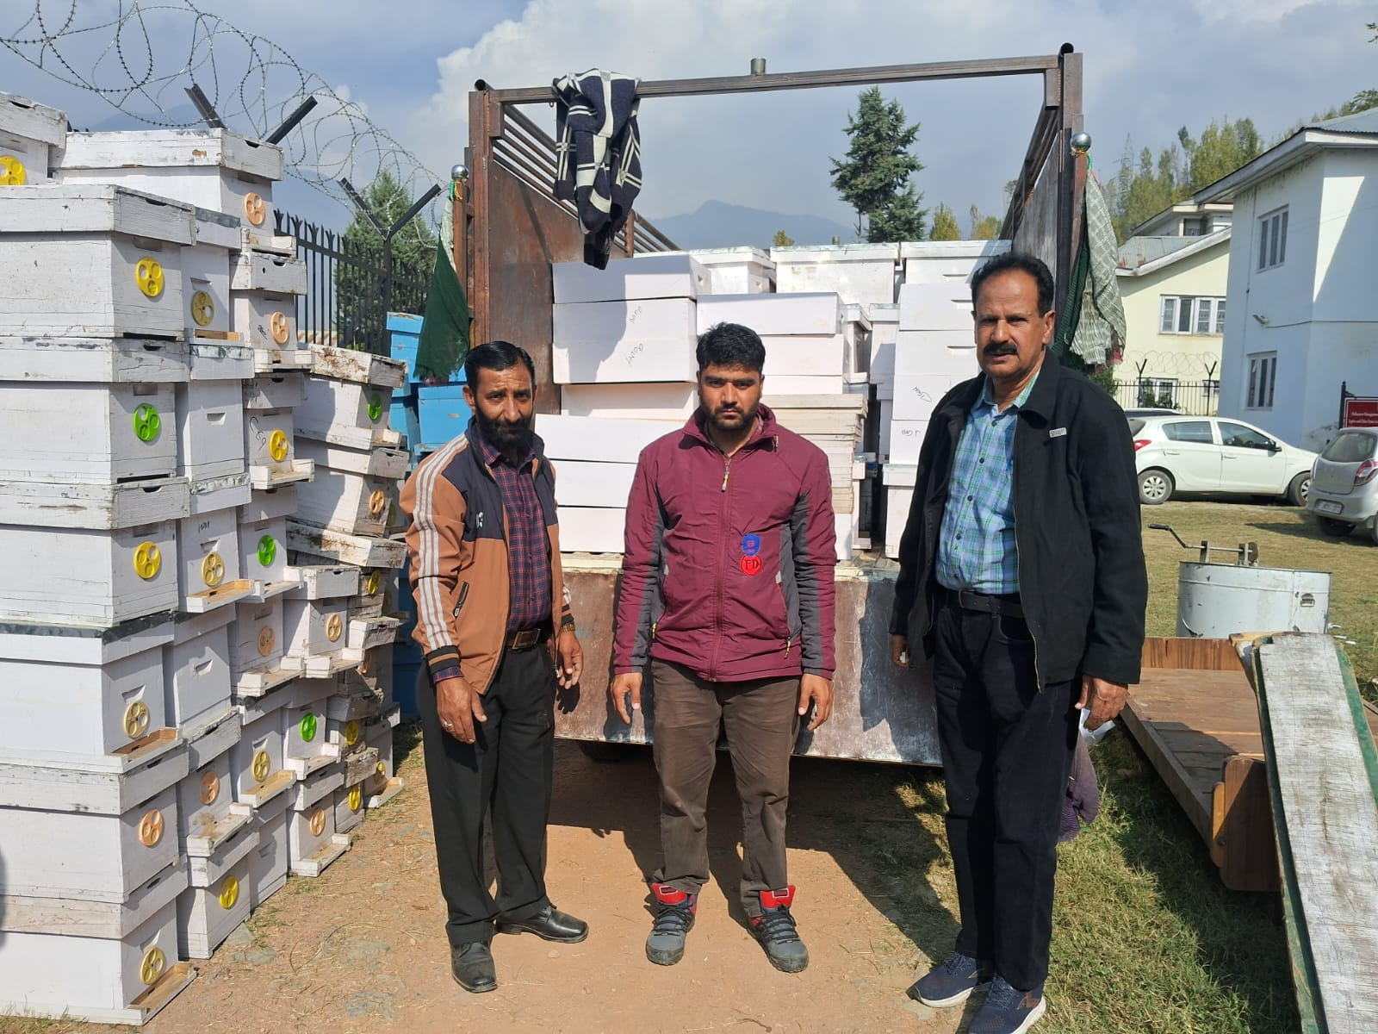
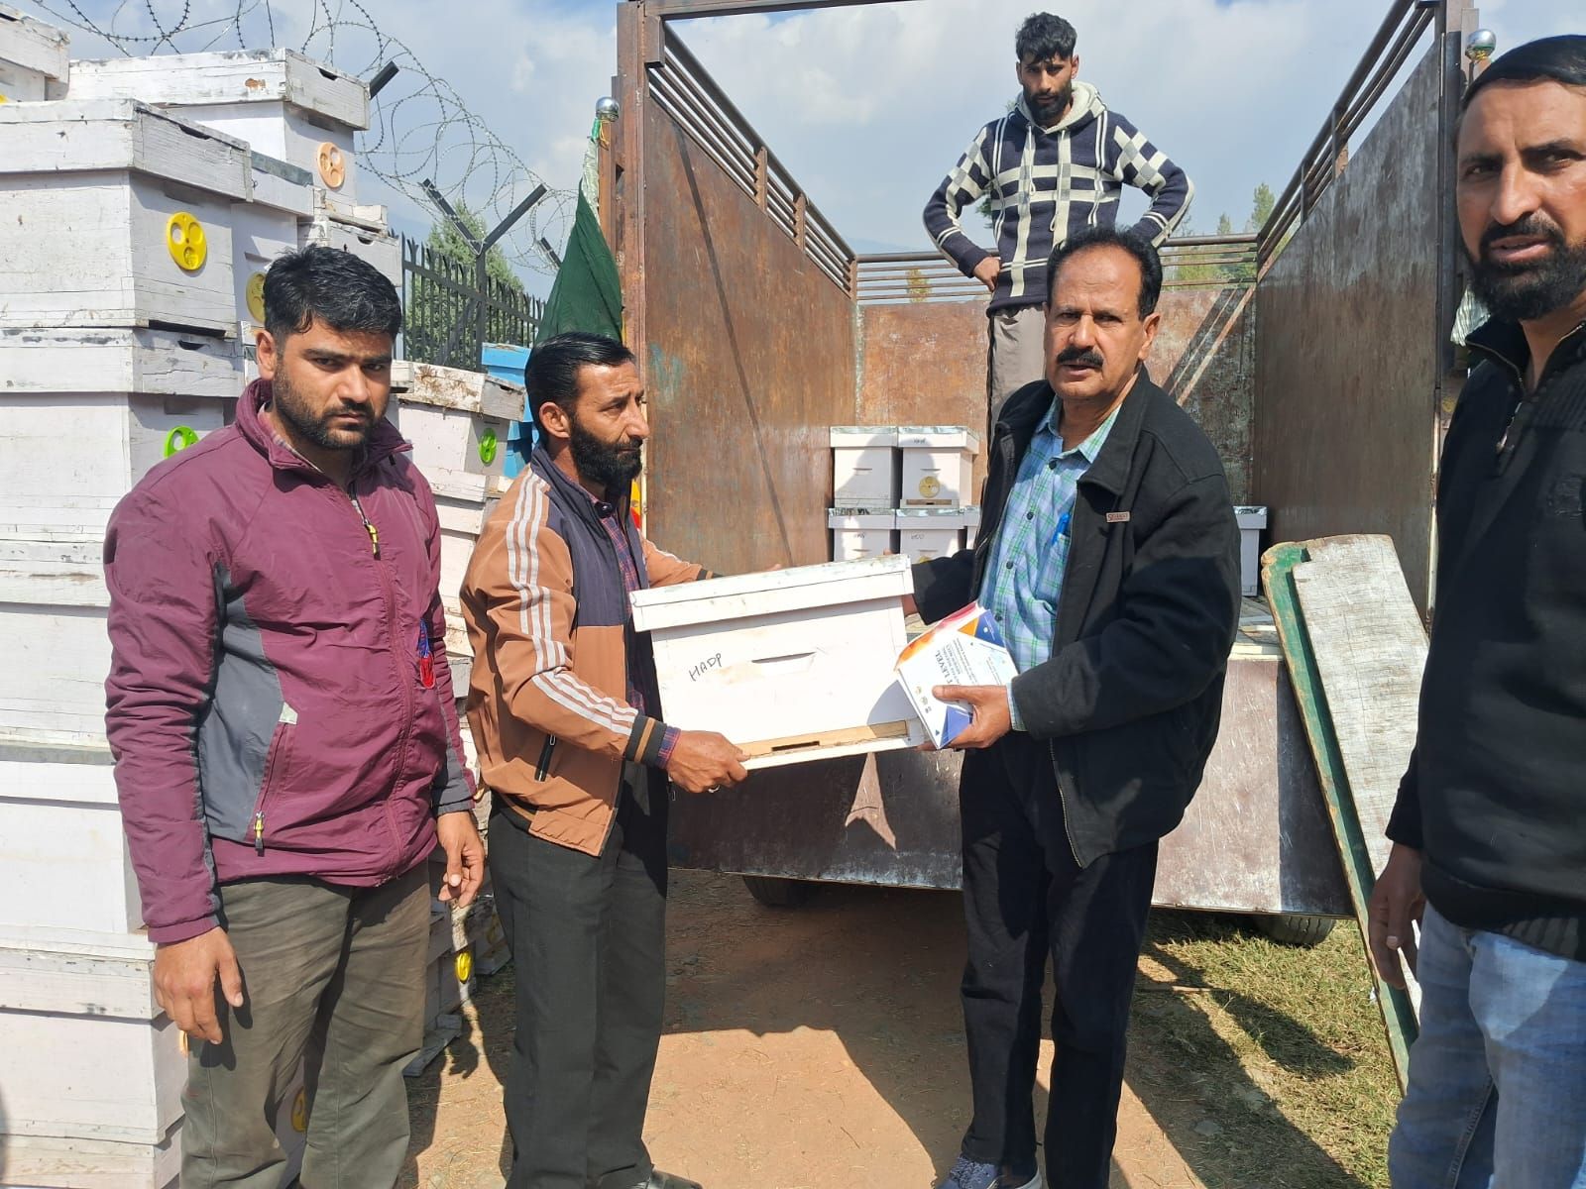
Distribution of Complete bee hives(17 Number) and 5 frame Nucleus hives (30 Number ) to FoA Wadura SKUAST-Kashmir for strengthening bee breeding Center and Upgradation of existing Apiaries on 22-10-2025 under HADP -06 Promotion of beekeeping in UT of J&K.

Slide 6
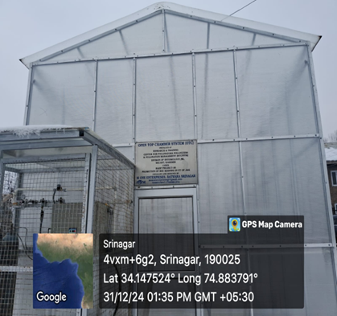
OPEN TOP CHAMBER

Slide 7
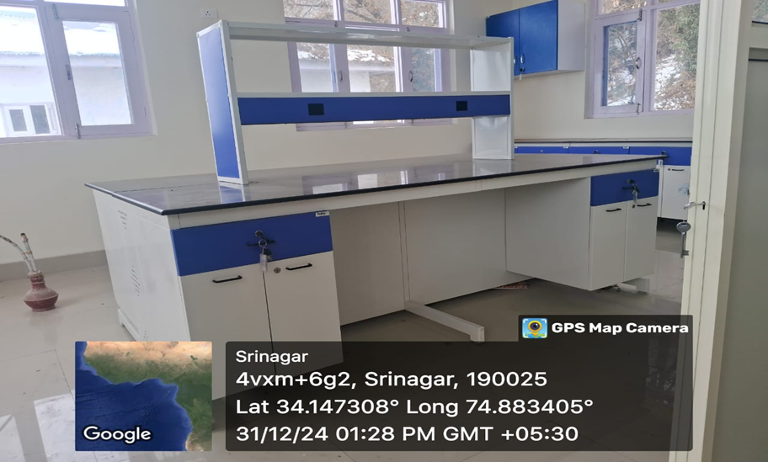
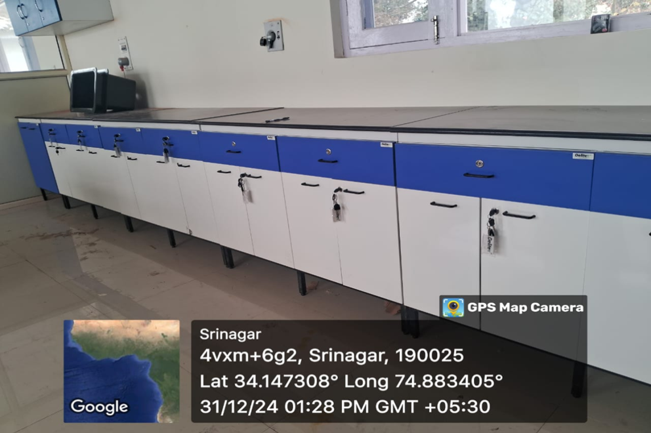
DISEASES DIGONOSTIC AND QURENTINE CENTER

Slide 8
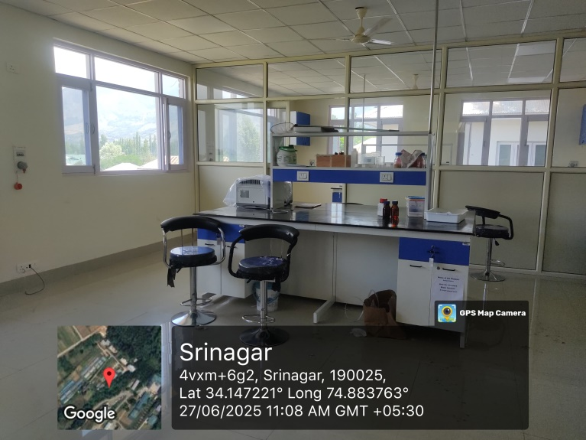
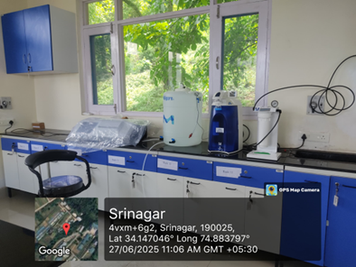
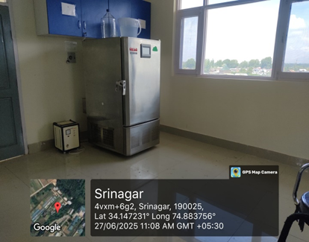
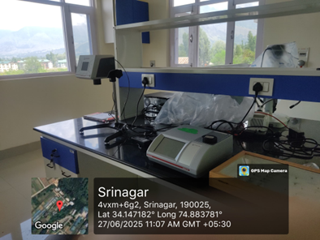
ALL THE EQUIPMENTS ARE FUNCTIONAL IN DISEASES DIGONOSTIC AND QURENTINE CENTER

Slide 9
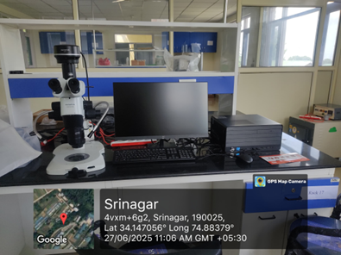
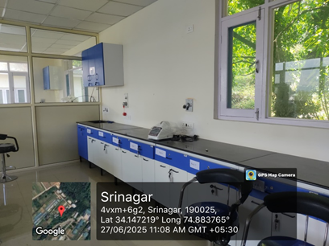
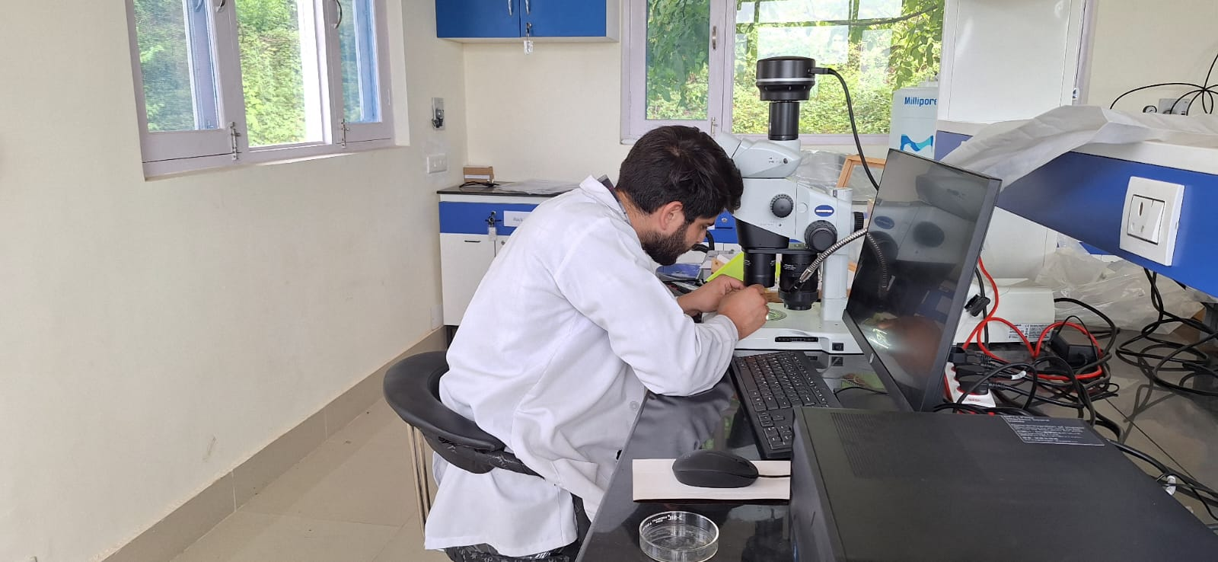
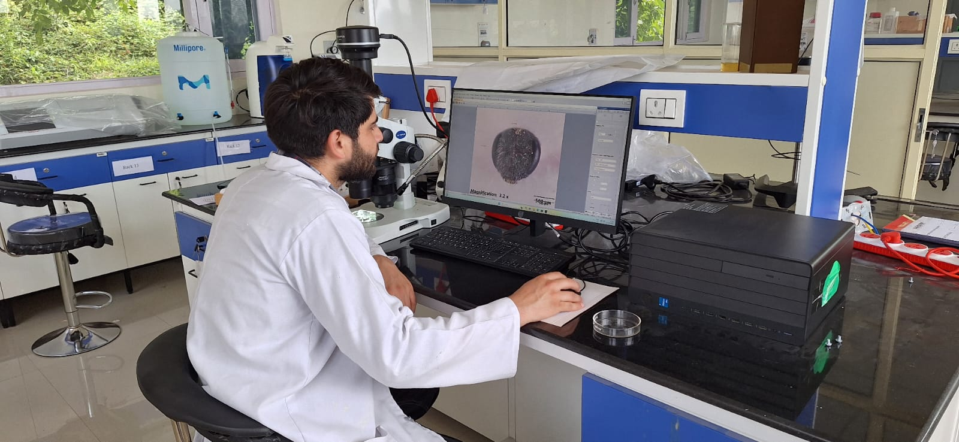
Sample Analysis at Disease diagnostic and Quarantine centre, RTCPPPM Division of Entomology SKUAST-K.

Slide 10
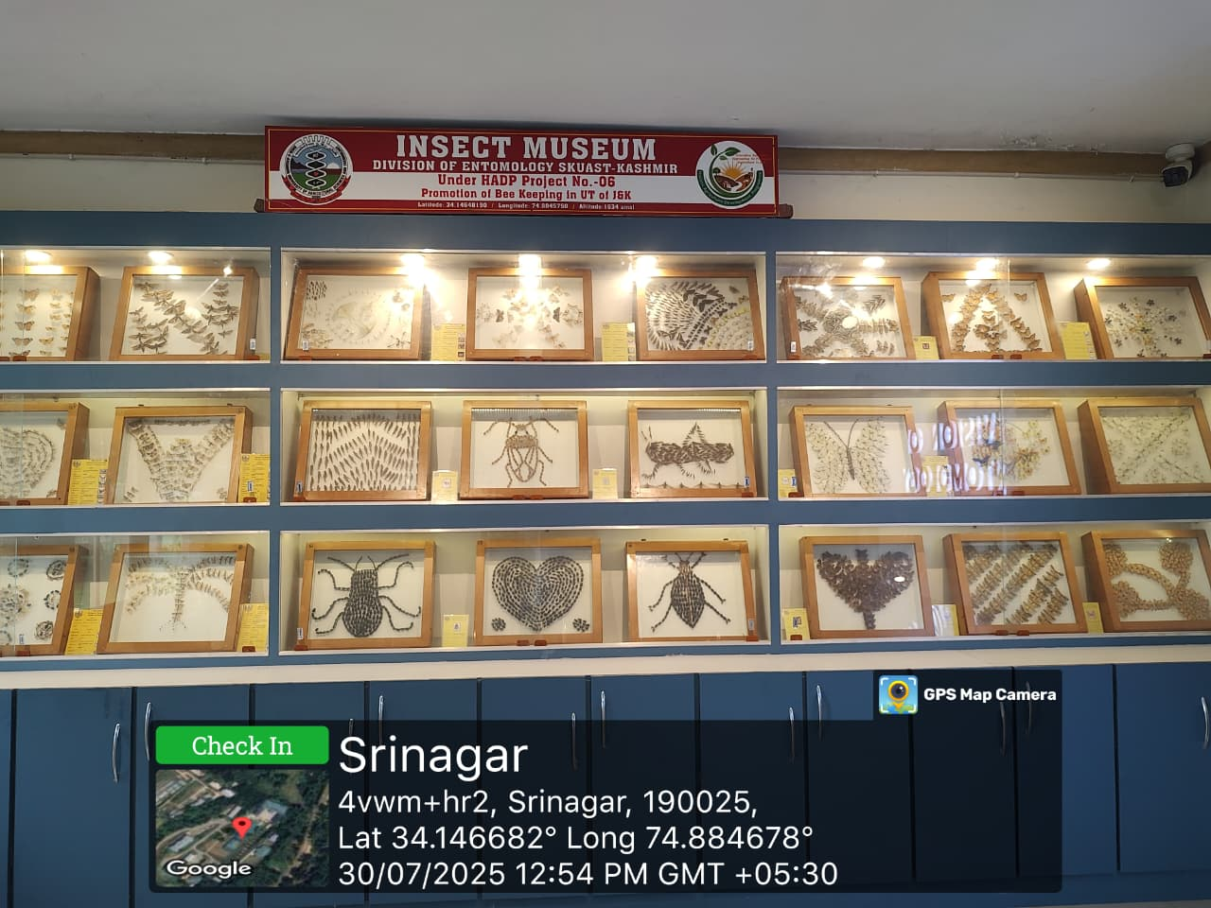
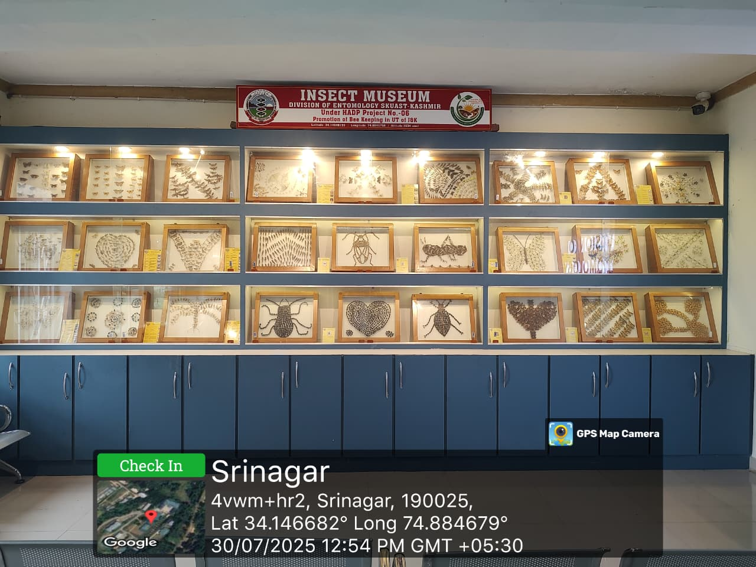
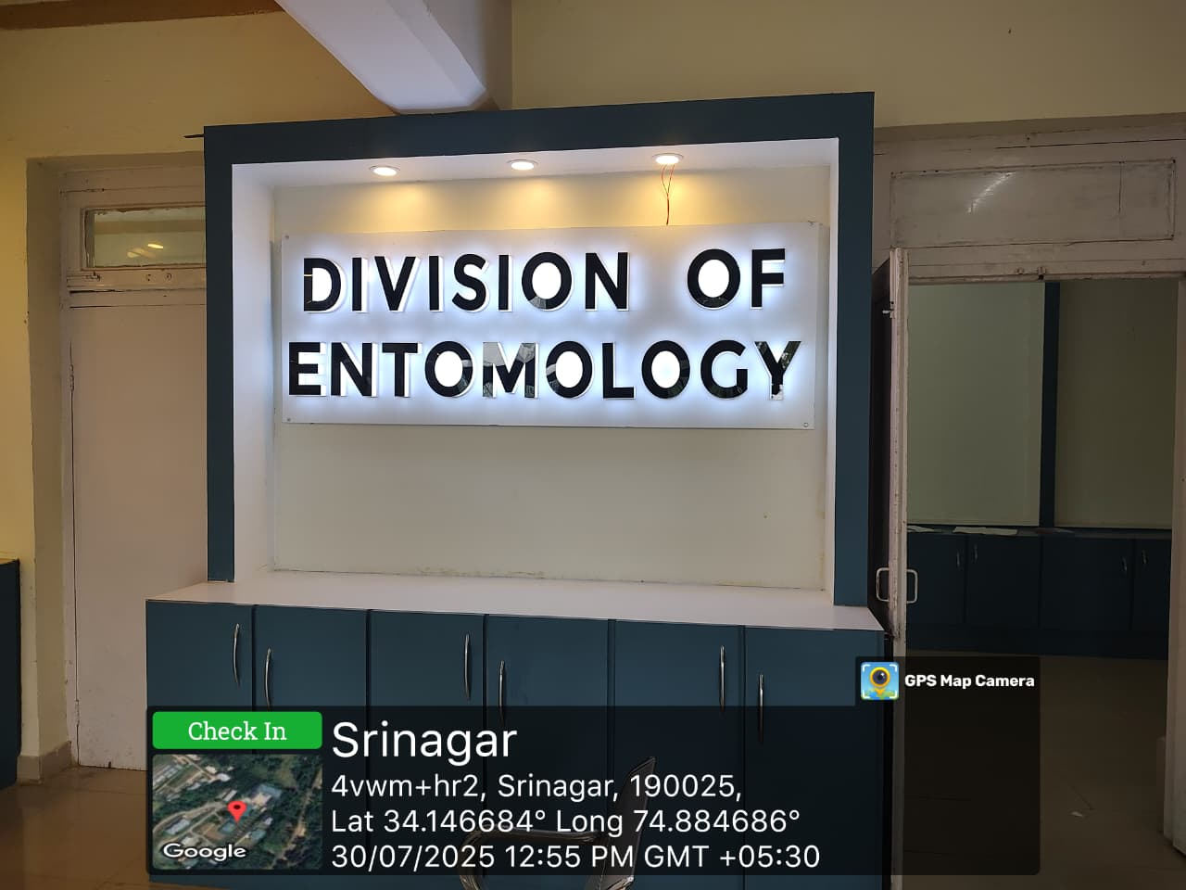
Insect Mini-Museum

